Slide 1
SUMMER INTERNSHIP
NIBHA RAJESH BELLE 4NM21CS096
DRIKSHA SATISH HEGDE 4NM21CS066

Slide 2


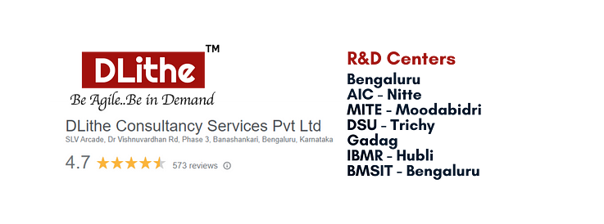
CYBERSECURITY
What is Cybersecurity?
Networking, different network topologies
OSI model, TCP/IP model
Cloud service models and cloud computing
Cryptography
Cyber Kill Chain Methodology which is divided into seven stages(reconnaissance, weaponization, delivery, exploitation, installation, command and control (C2), and actions on objectives).It is a part of the Intelligence Driven Defense model for identification and prevention of cyber intrusions activity.

Slide 3
Case Studies
The very first case study was on the topic 1-facror, 2-factor and 3-factor authentication.
Man-in-the-middle-attack made me realize how smart the hackers can be.
Finding the IP address of any five websites.
Capital one attack : Ways through which hacking can be done to acquire data on large scale.
LinkedIn data breach: This case study gave information on how data can be hacked on a massive scale. This attack exposed information of 700million LinkedIn user's. This hacking was done by misusing APIs to perform ‘data scraping’ to collect publicly available information from websites. We also got to know that the leaked contact details and data can be further used in phishing and identity theft attacks.

Slide 4
PROBLEM STATEMENTS
Installing various software
Password cracking (offline mode)
Password cracking (online mode)
Exploiting Metasploit
Nmap commands
Cisco packet tracer
Malware attack using msfvenom
Footprinting and reconnaissance

Slide 5

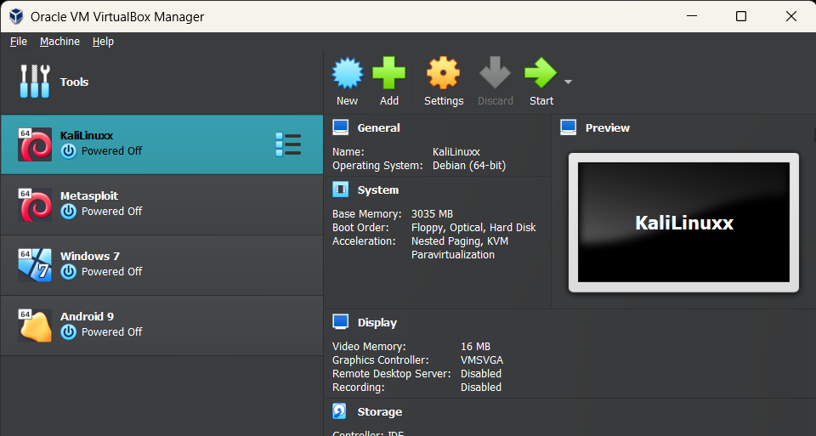
SOFTWARES USED
Oracle Virtual Box
Kali Linux
Metasploit
Windows 7
Android 9

Slide 6
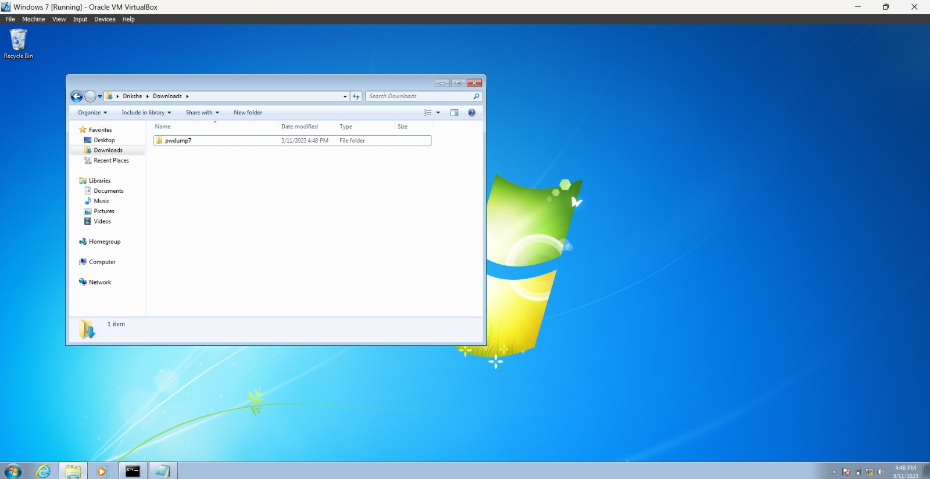
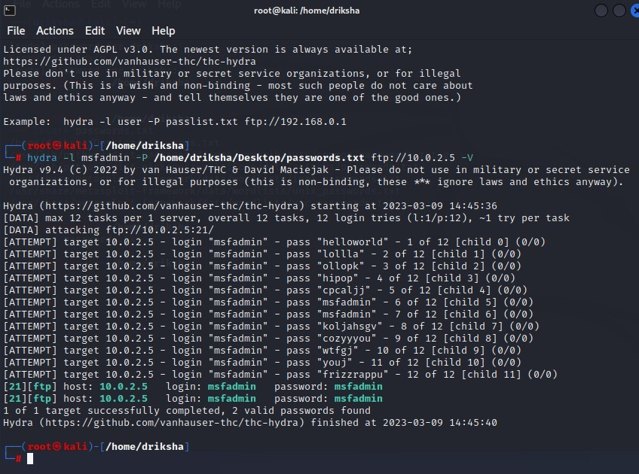
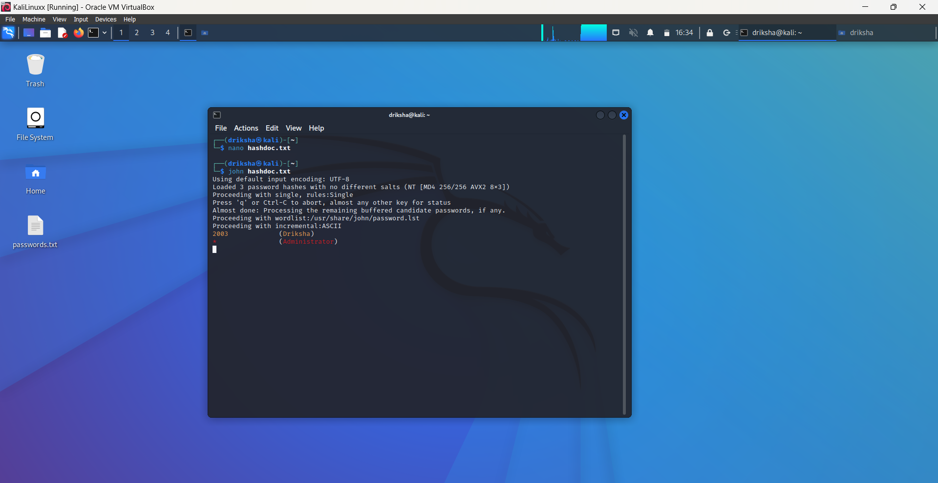
Password cracking (OFFLINE)
Windows 7
Metasploit machine using hydra
(ifconfig, nbtscan -r 10.0.2.0/24, ftp 10.0.2.5)

Slide 7
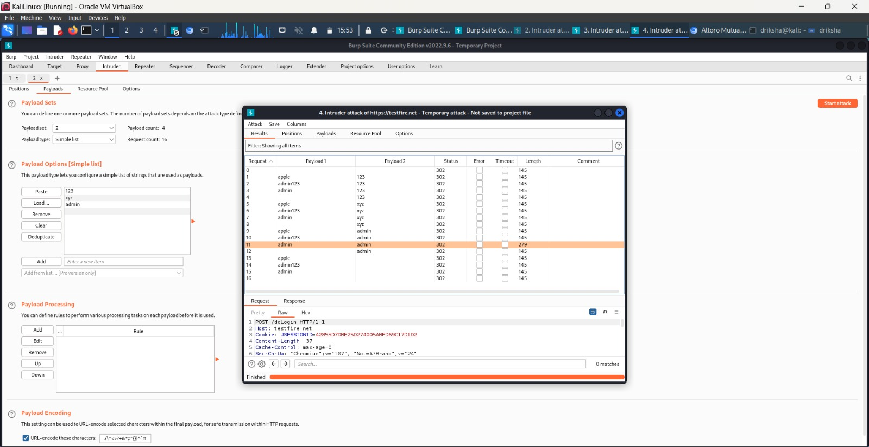
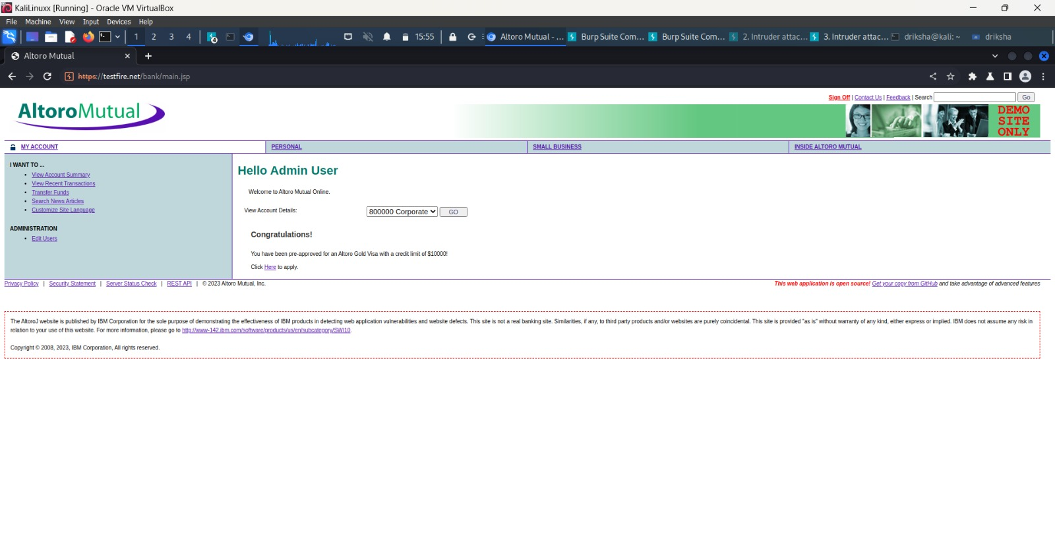
Password cracking using burpsuite
Open BurpSuite, Set Up Proxy,
Capture Login Request,
Send Request to Intruder,
Prepare attack, Check Successful Login

Slide 8
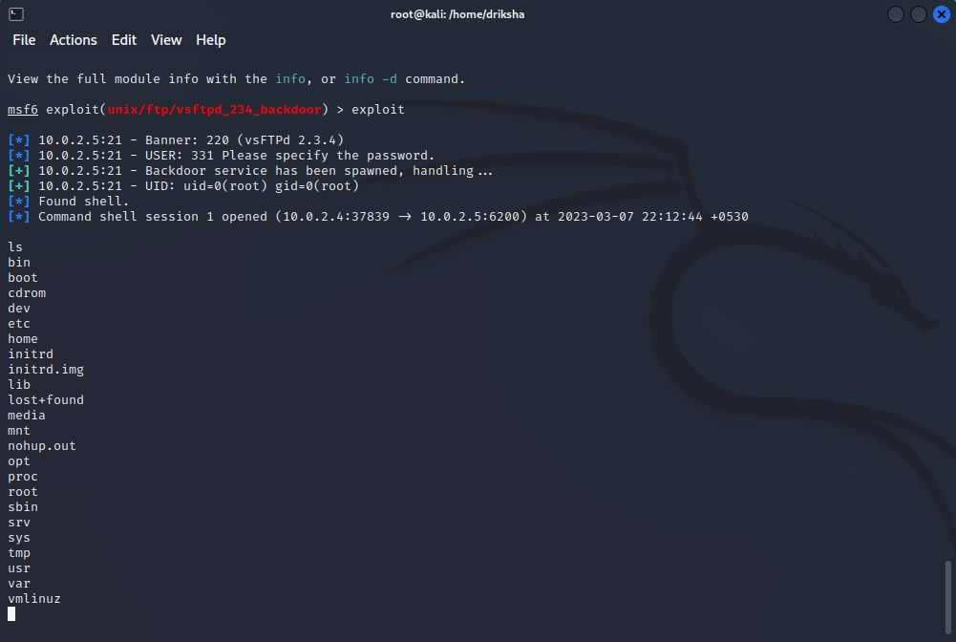
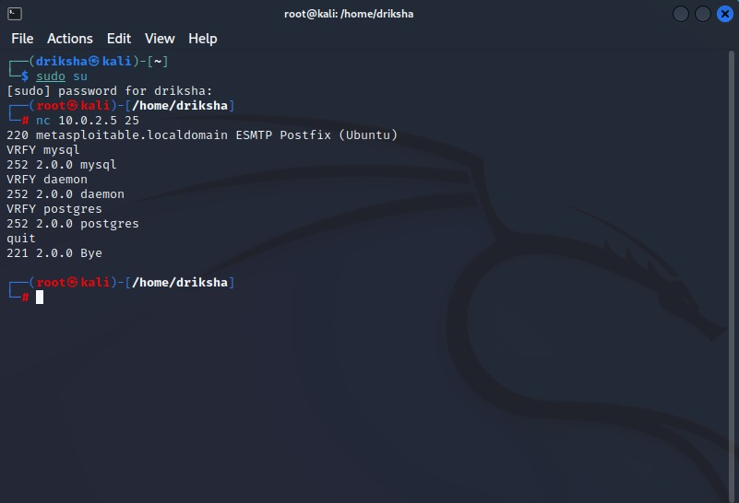
Exploiting Metasploit
ftp
smtp

Slide 9
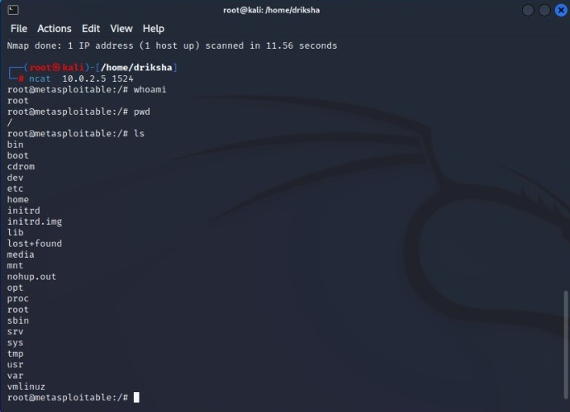
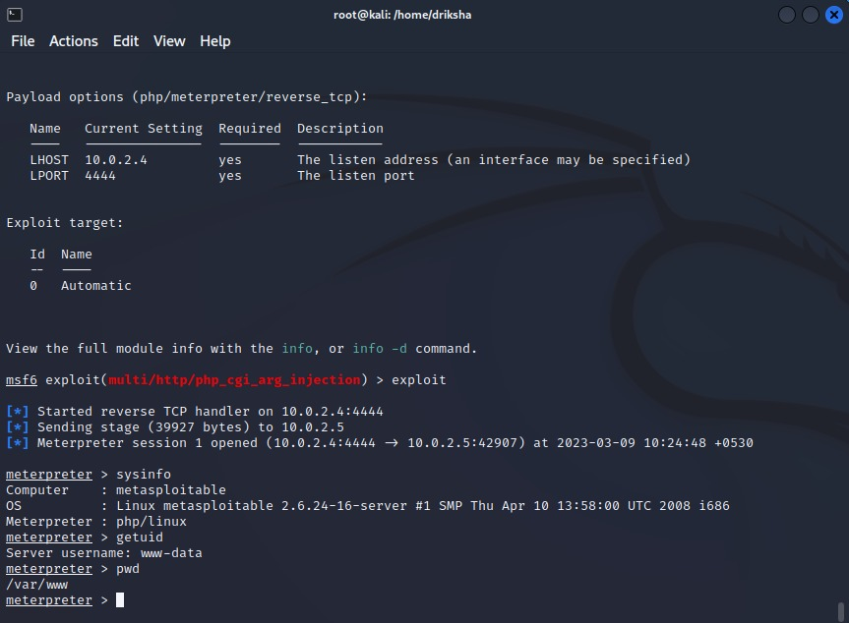
Exploiting Metasploit
Bind shell : A bind shell is a sort of setup where remote consoles are established with other computers over the network. In Bind shell, an attacker launches a service on the target computer, to which the attacker can connect.
http

Slide 10
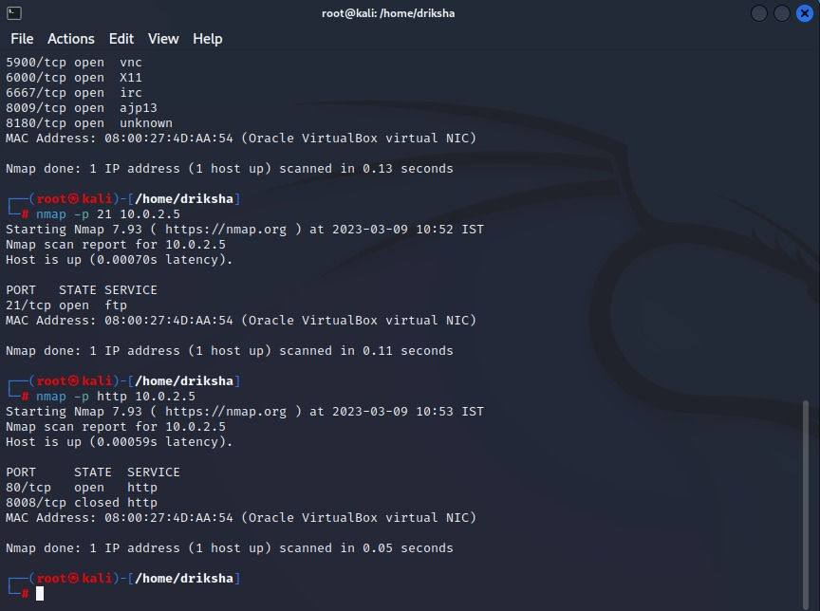
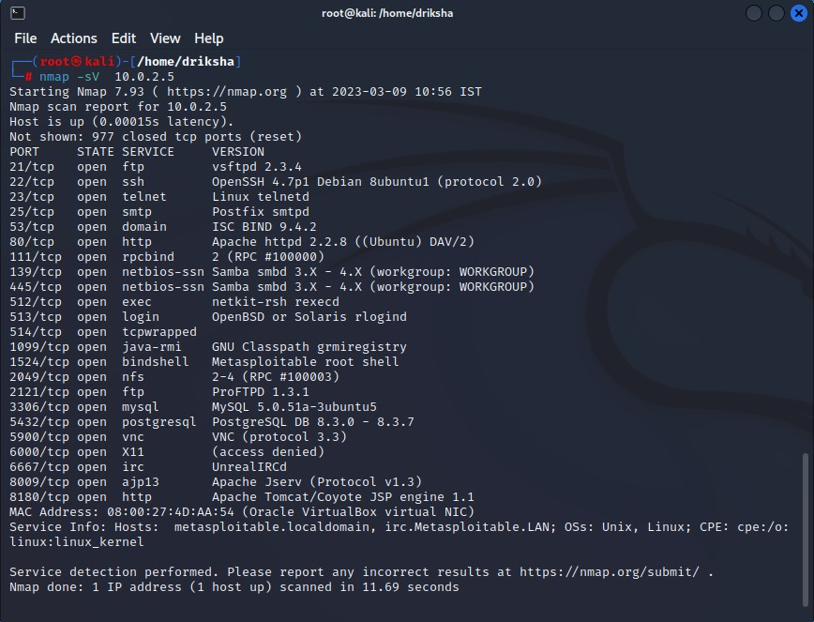
Nmap commands
-p
-sV

Slide 11
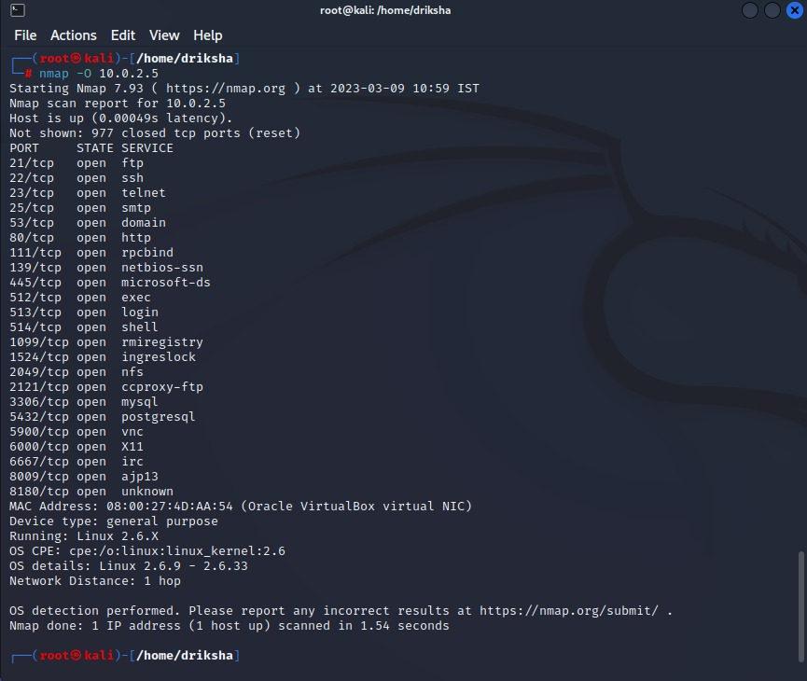
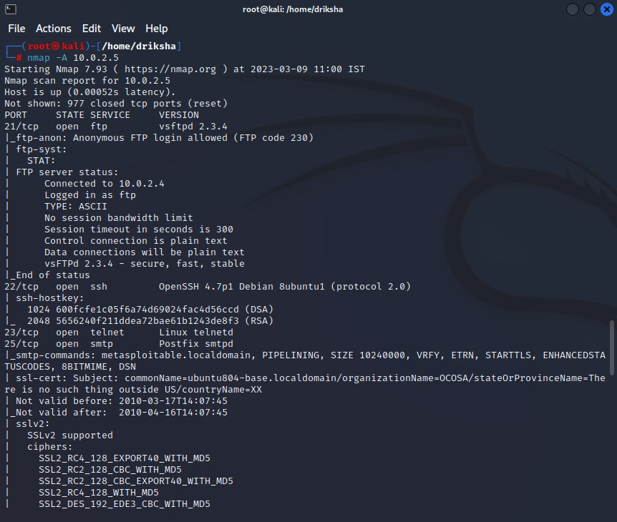
Nmap commands
-O
-A

Slide 12
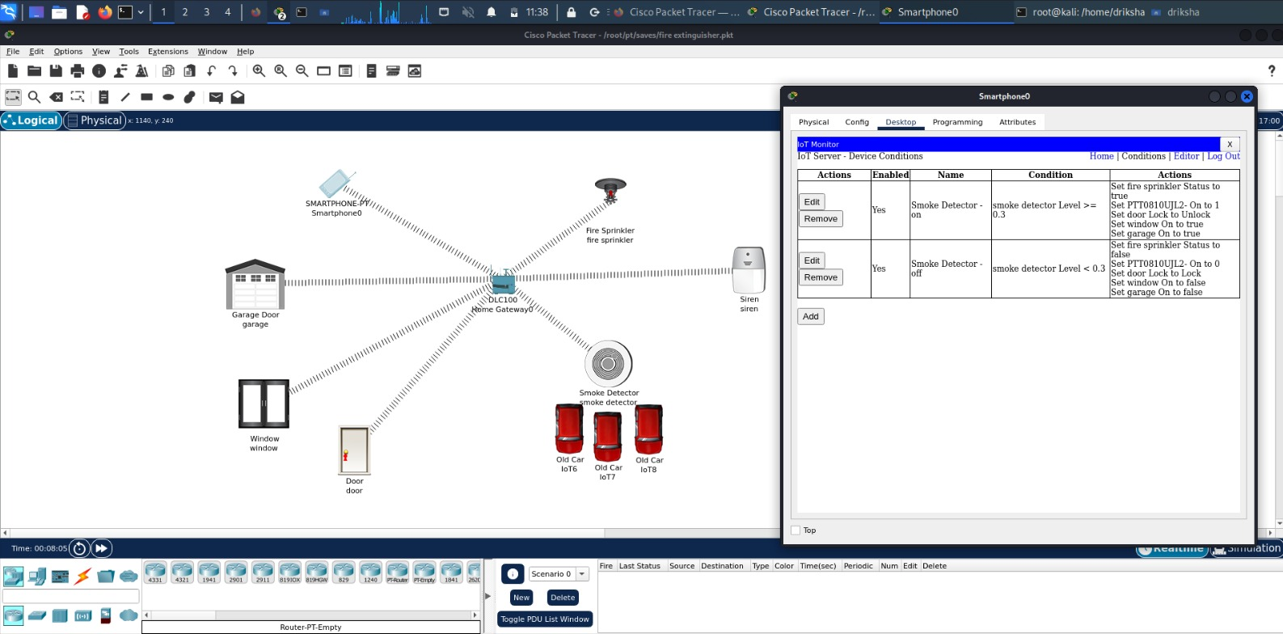
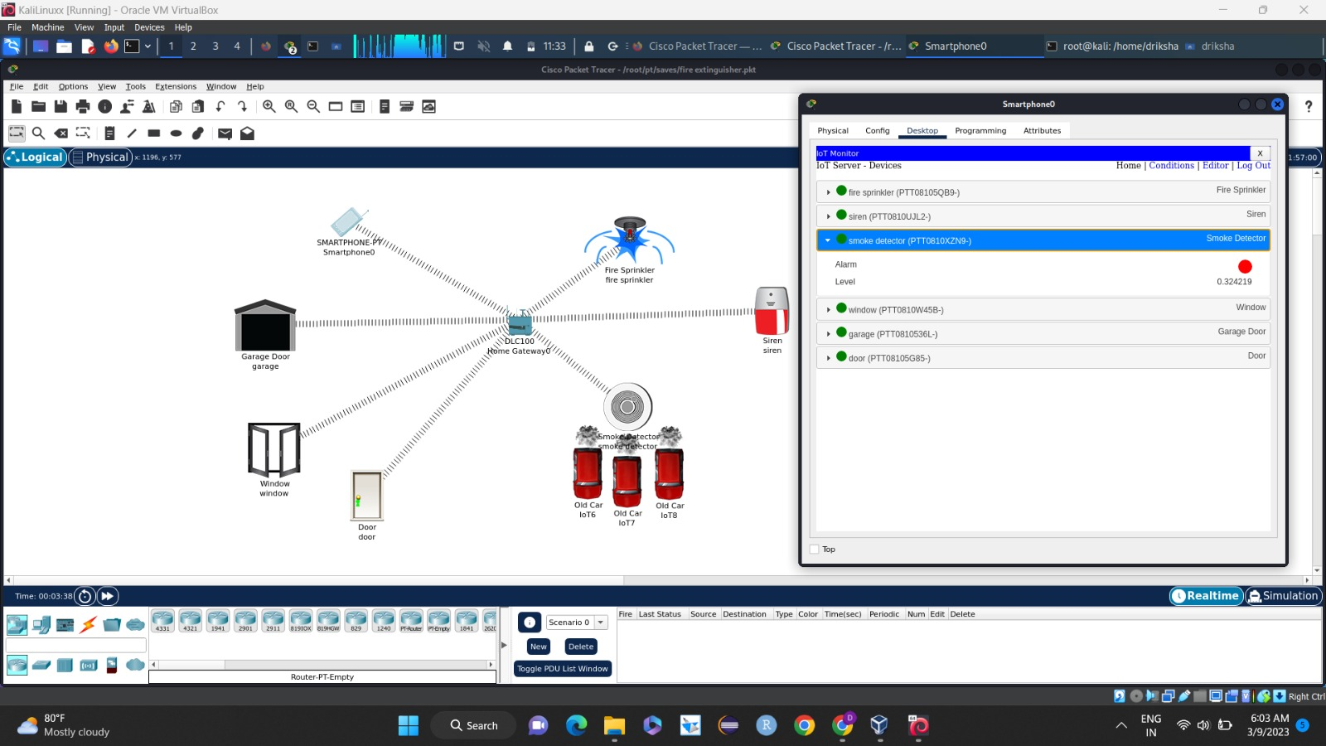
Cisco packet tracer

Slide 13
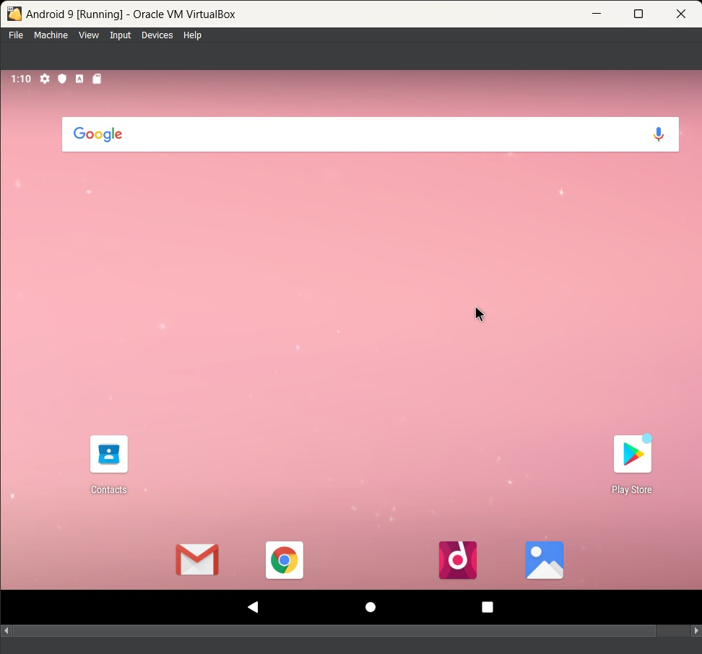
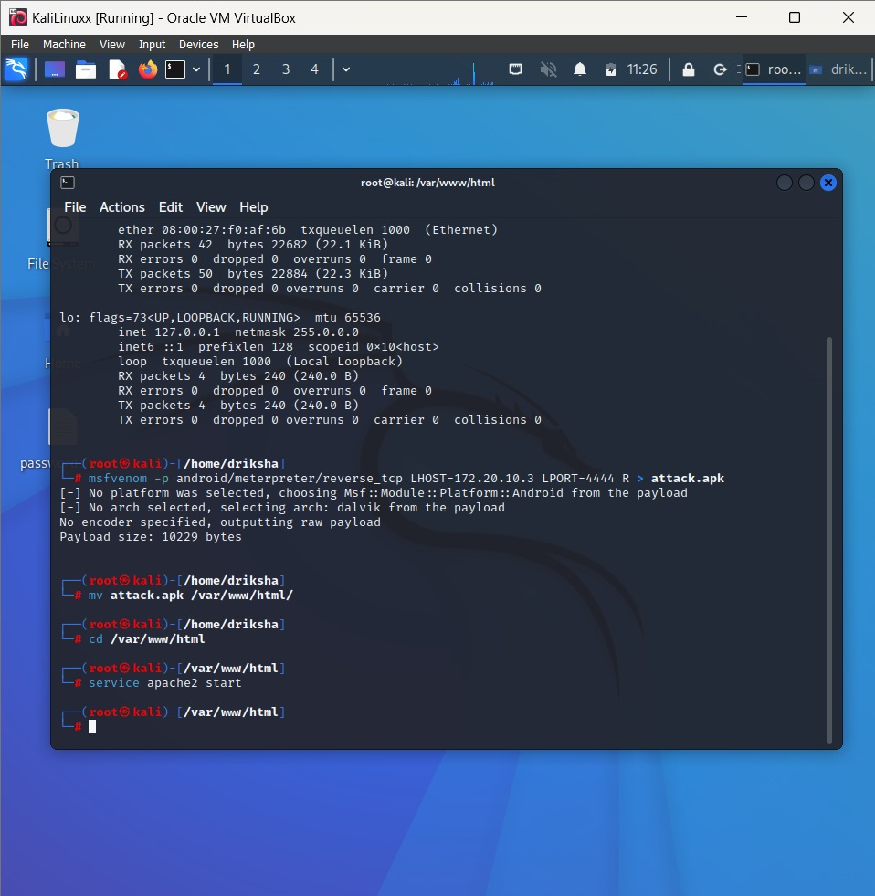
Malware attack

Slide 14
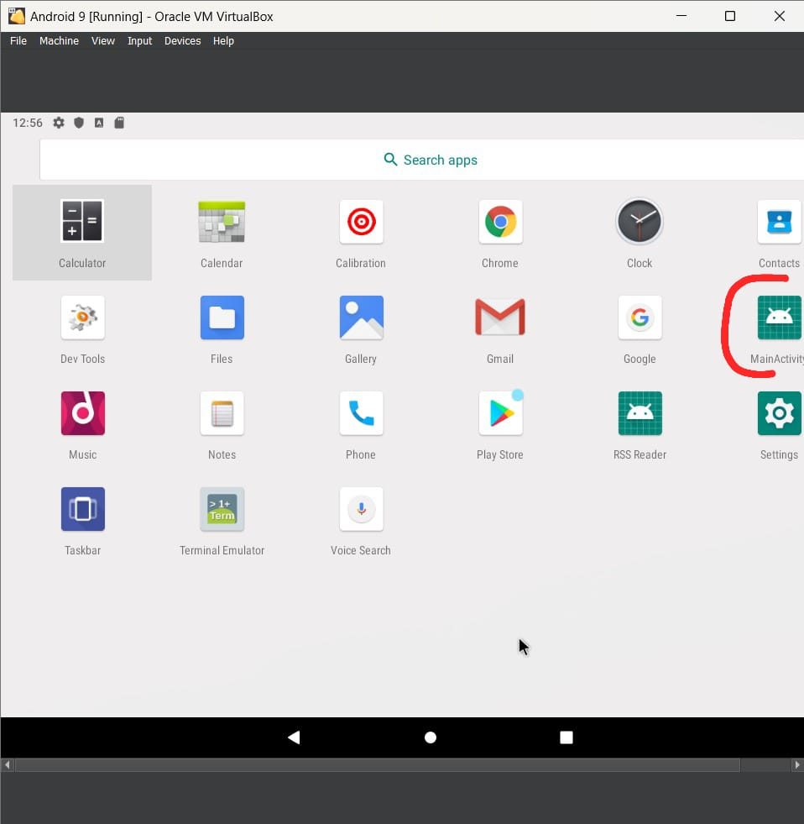
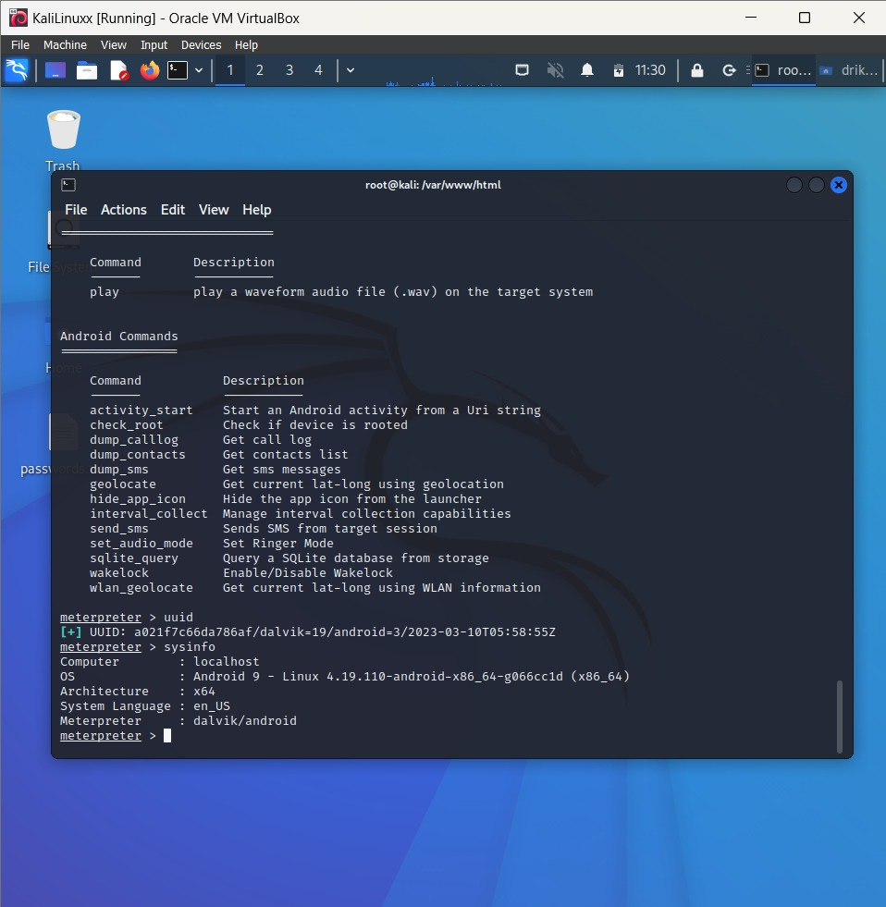
Malware attack

Slide 15
FOOT PRINTING : Means gathering information about a target system which can be used to execute a successful cyber attack.
RECONNAISNACE : refers to the initial phase of an attack or security assessment where an attacker or security professional gathers information about a target system or network.
Google Dorking : Also named Google hacking, is a hacker technique that uses Google Search and other Google applications to find security holes in the configuration and computer code that websites are using.
Netcraft : Netcraft plays a significant role in the field of cybersecurity by providing various services and tools to help organizations protect themselves against online threats.
Whois : is a protocol and a database query tool used to retrieve information about domain names and IP addresses. It provides information about the registered owner, the organization or individual responsible for the domain, their contact details, registration and expiration dates, name servers, and other relevant information.
BuiltWith : It is a web technology profiler and analysis tool that provides information about the technologies used on websites. It helps individuals and businesses gain insights into the technology stack, frameworks, content management systems, e-commerce platforms, analytics tools, advertising networks, and other technologies employed by websites.

Slide 16
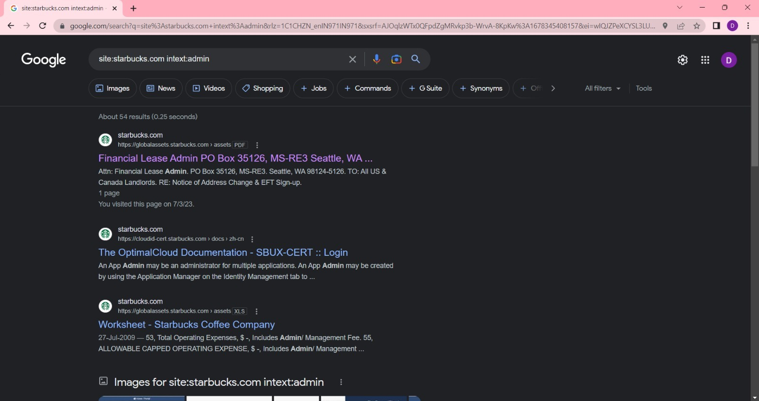
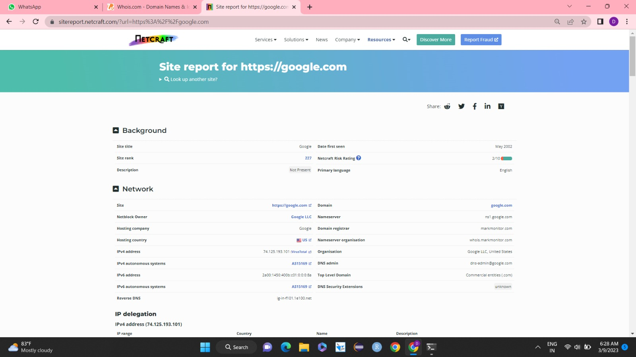
Footprinting and reconnaissance
Google Dorking
Netcraft

Slide 17
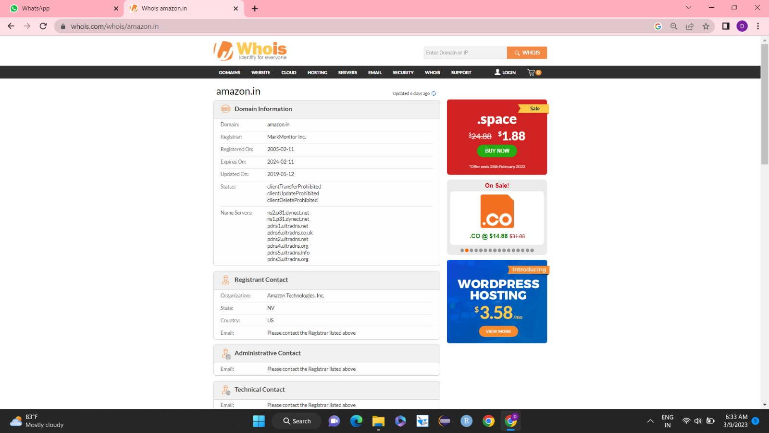
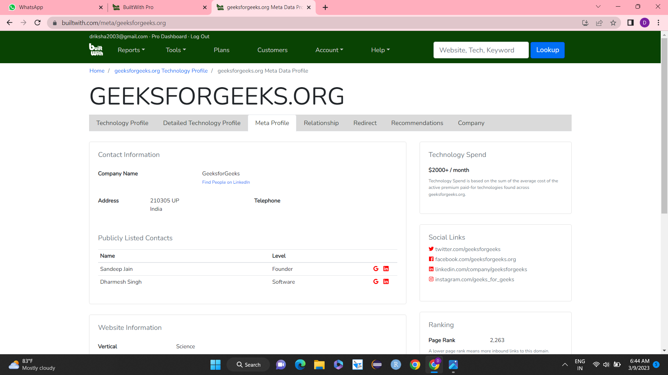
Whois
Builtwith

Slide 18
EXPERIENCE
Gained Practical Knowledge
Developed Technical Skills
Enhanced Analytical and Problem-Solving Abilities
Ethical Awareness
Networking and Professional Development

Slide 19
THANK YOU

